Slide 1
Arnold’s Cat Map
A Primer by Noah Dunn

Slide 2
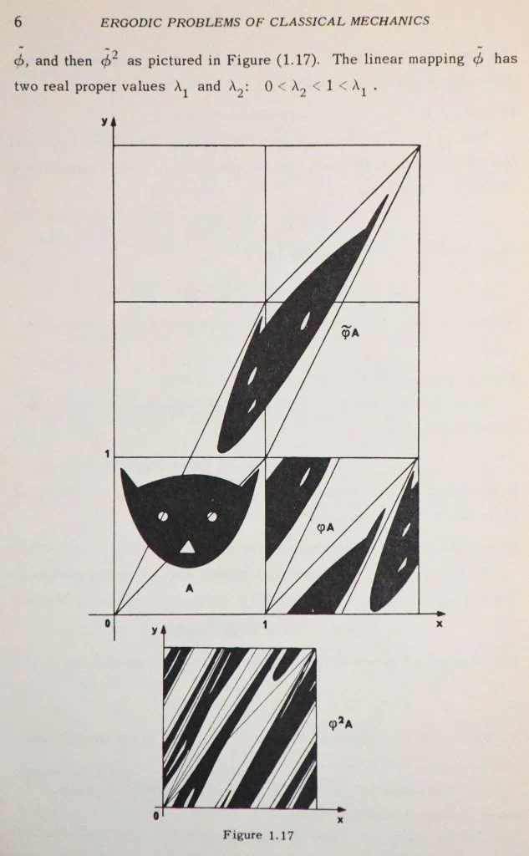
Where does this topic originate?
This is a chaos theory topic created in the 1960s
Vladimir Arnold, a prominent Chaos Theory mathematician wanted to illustrate visual application of chaos mapping
The original image used was that of a cat, which is why it is referred to as Arnold’s “Cat Map”
Image Credit: Galileo Unbound

Slide 3
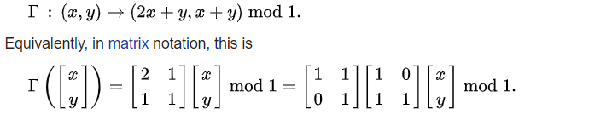
What are the underlying mathematics?
The Cat Map boils down to properties of Matrices, as well as the power of Modulus division
A Matrix is used to map the sections(pixels) of an image to values, and the multiplication enables us to move pixels around constrained by modulus division
If done enough times, the image will eventually return to the original state
Source: Wikipedia

Slide 4
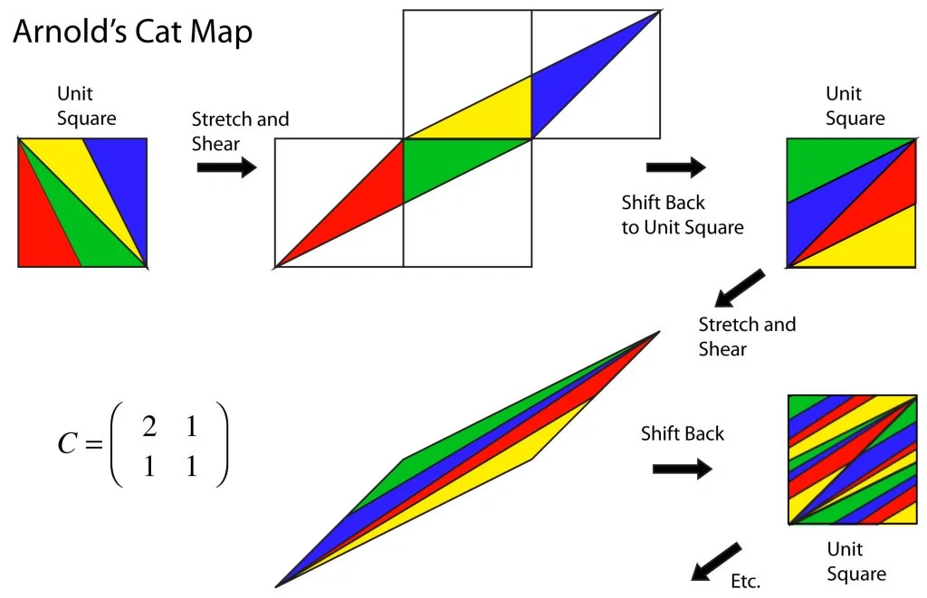
How do these operations look in 2D?
Image Credit: Galileo Unbound
The multiplication operation that we use causes every single picture segment (pixel) to appear in 1 of 4 quadrants based on initial placement in the start image
The modulus division then bounds every pixel back into the width/height of the initial image, with no overlap
This is a lossless procedure
This requires Square images

Slide 5
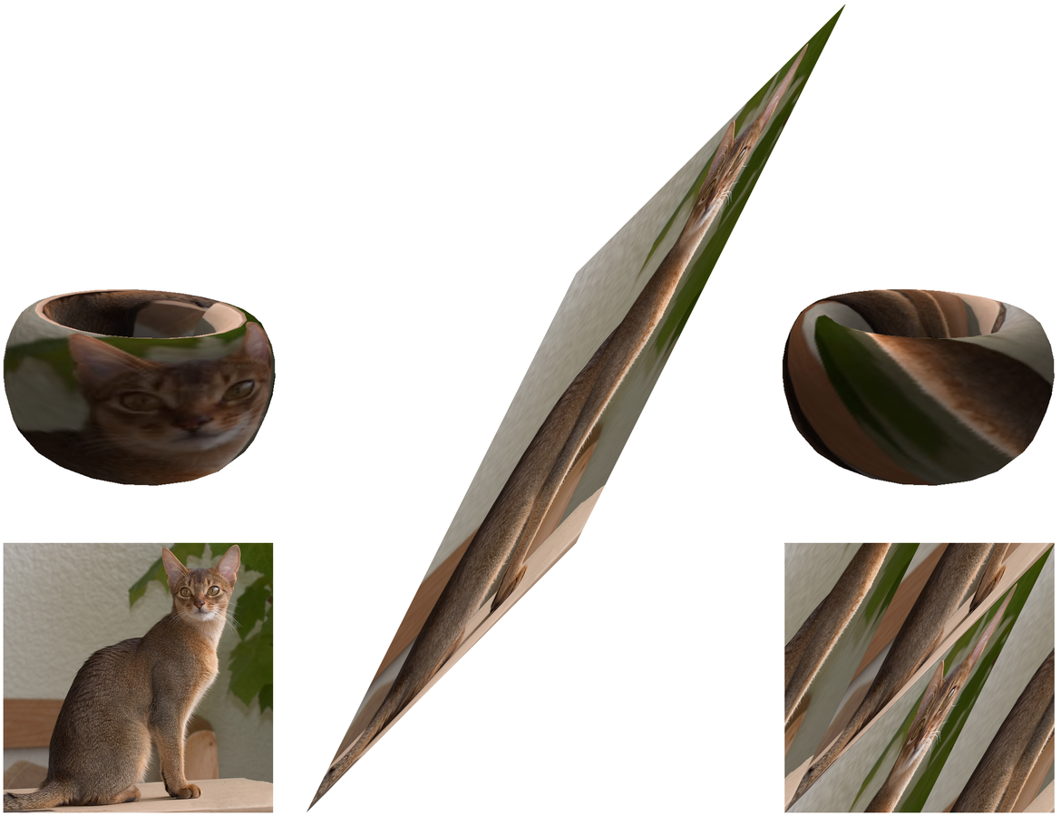
How do these operations look in 3D?
Another way to look at this problem is to imagine a 2D image being wrapped around a Torus (3-D Donut Shape), and being pulled around step by step.
This results in a very peculiar image that holds its properties in 3D
Source: French Wikipedia

Slide 6
Practical Applications
We can make some very crazy pictures from any given picture after only a few steps in the Cat Map
This technique has been used for Image Cryptography, as the procedure is very easy to undo if the recipient is aware of how the image was encrypted
These operations can be done very quickly, requiring only 1 multiplication, 2 additions, and 2 mod operations per pixel
It is has been shown that the number of required shifts to get back to the original image will never exceed 3 times the width/height of the image, as proven here.

Slide 7
Sources + Additional Resources
https://www.jasondavies.com/catmap/
http://pages.physics.cornell.edu/~sethna/teaching/562_S03/HW/pset02_dir/catmap.pdf
https://en.wikipedia.org/wiki/Arnold%27s_cat_map
http://mathworld.wolfram.com/ArnoldsCatMap.html
https://galileo-unbound.blog/2019/06/16/vladimir-arnolds-cat-map/

